Slide 1
Conference:
Generic Drugs in Turkey and the EU
THE PORTUGUESE MODEL FOR STIMULATING GENERIC COMPETITION IN THE EU
June 2, 2005, Ankara, Turkey
Rui Santos Ivo
President of INFARMED
National Institute of Pharmacy and Medicines
Ministry of Health, Lisbon, Portugal
rsantos.ivo@infarmed.pt

Slide 2
INFARMED Complex
Lisbon
OMCL Laboratory
& Conference Centre

Slide 3
INFARMED
Legal Status : Public institute with financial and administrative autonomy;
Established in 1993, under the Authority of the Ministry of Health and Ministry of Finance
Budget (2005): 23 700 000 €
Staff: 330
150 External Experts from Universities and Health Services
Notes:
Staff: 330
92 pharmacists
30 medical doctors
Other degrees: economy, management, mathematics, law, informatics, biology, chemistry, genetics, public relations, international relations
Experts:
150 highly qualified experts working in medicines evaluation
Participation in European Groups: 86

Slide 4
INFARMED Mission
National competent authority for the evaluation, authorisation, reimbursement evaluation and control of medicinal products for human and veterinary use and other health technologies, assuring its quality, safety and efficacy, preventing risks and promoting their safe and rational use.

Slide 5
Areas of Intervention & Activities
Areas of Intervention
Human Medicinal Products
Veterinary Medicinal Products
Medical Devices
Herbals
Homeopathics
Cosmetics
Activities
Evaluation and authorisation of clinical trials
Evaluation and authorisation of human and veterinary medicines
Evaluation for reimbursement decisions
Quality Control Laboratory
Licensing of pharmaceutical premises
Inspection GMP, GLP, GCP, …
Pharmacovigilance
Information, Communication and Transparency
Technical and Scientific Commissions (8)
Notes:
Medicinal Products Evaluation Commission
Pharmacovigilance Commission
Pharmacoeconomics Commission
Portuguese Pharmacopoeia Commission
Committee for the technical evaluation of in vitro medical devices
Technical-Scientific Commission on Cosmetology
Commission for the national formulary of hospital medicinal products
National Council for medicinal products advertising
CEIC é independente

Slide 6
SUMMARY
Background
Medicines policy
Results
Current issues

Slide 7
BACKGROUND

Slide 8
Background 2001
Inexistence of a Generics Market
0,34% in 2001
Structural and Sustainability Problems in NHS
Previous years - 10% average growth of the NHS expenditure on medicines
Lack of awareness about generics

Slide 9
Portuguese Medicines Policy on Generics
In implementing a new Medicines Policy a
different set of elements and interests have to be considered
Public Health
Access
Innovation and Quality
Sustainability of Health System
Efficacy and Safety
Pharmaceutical Industry
All Stakeholders have Responsibilities in Promoting Public Health

Slide 10
MEDICINES POLICY

Slide 11
Objectives of the Medicines Policy
Focused on the Citizen - serving patients and citizens
Rationalisation of costs for Patients & State
Promotion of efficiency and health gains
Promotion of better information on medicines
Incentives to the Pharmaceutical Industry
Access to innovation
Review of Pharmaceutical Legislation/G10 Process outcomes

Slide 12
Policy Measures
Promotion of generics
Reference Pricing System
Based on the highest price of generics (Initially yearly/Now quarterly)
Additional reimbursement for low income patients
INN prescribing
For all medicines with generics
Prescription rules
Standardised, renewable, electronic
Extra 10% reimbursement for generics

Slide 13
Policy Measures
Reinforced role of physicians and pharmacists on providing information about availability of generic medicines
Pharmacist substitution possible under certain conditions
Physician has three options (authorise, not authorise, do not decide)
Information Strategy from the Ministry of Health

Slide 14
Regulatory Measures
Reduction of timeframe for authorisation and reimbursement
Increase transparency through public information on substances under evaluation
Simplified procedure for reimbursement
Development of Mutual Recognition Procedure
Development of quality control activities
Specific quality testing for generics
Results made publicly available

Slide 15
Regulatory Measures
Wide information strategy
Campaigns directed to the general public (TV, radio, newspapers, door to door)
Dedicated area in our website
Information on newspapers, publications
Quarterly brochures to health professionals
Specific publications

Slide 16
Regulatory Measures
Information programme for health professionals
Information sessions for healthcare professionals on the system of quality control of medicines in particular generics
Visits by health professionals to INFARMED quality control Laboratory
Sessions at regional health centres on the rational use of medicines and therapeutic alternatives

Slide 17
Other measures
Release of monthly reports on the use of generics in the national market at www.infarmed.pt;
Release of authorisation/evaluation monthly perfomance indicators agreed on common WG with industry association at www.infarmed.pt;

Slide 18
Other measures
Release of pharmaco-therapeutic evaluation reports for the reimbursement of new active ingredients;
Publication of a list of generic medicines under evaluation;

Slide 19
Medicines Policy
The 2002 medicines policy was about eficiency and health gains into the NHS. Problems could only be tackled with a variety of measures going from the promotion of generic medicines, the reorganisation of hospital pharmacies, the establishment of incentives for the industry or actions at INFARMED level as the readjustment of internal working procedures to increase efficiency in reducing evaluation timeframes and producing more specialised information for stakeholders.
The reform has been much more than simple generic promotion. However in three years generics market is at 12% with sustainable growth, it contributed for important savings for patients and NHS (health gains) and allowed the consolidation of a number of national generic companies at national and international levels.

Slide 20
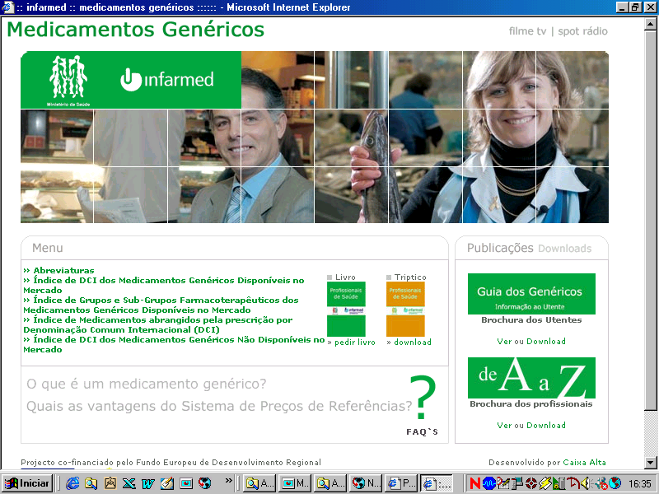
Notes:
Nesta problemática da Informação sobre medicamentos, não nos podemos alhear do facto do doente constituir a nossa referência central. Desta forma, todos os parceiros em saúde, serão parceiros no “Fluxo de informação”, para a “Maximização da Efectividade” desta ferramenta terapêutica que é o MEDICAMENTO!

Slide 22
G 10 Workshop, 2003, Lisbon
The workshop identified a number of measures that EU Member States should consider for stimulating the availability of generics:
Educating doctors to use INN names.
Assisting doctors in understanding the economic implications of prescription decisions.
Increasing the use of electronic prescribing.
Creating substitution lists.
Increasing incentives for generic dispensing and substitution (regarded as particularly important in systems where doctors are not economically sensitive).

Slide 23
G 10 Workshop, 2003, Lisbon
Improving consumer awareness of generic quality and availability.
Increasing pharmacoeconomic evaluation of new products in comparison with existing products.
Establishing generic-oriented reimbursement and health insurance systems.
Adopting reference pricing and free pricing systems instead of controlled price systems.
Reducing the time delay between receiving market authorisation for a generic product and gaining pricing, reimbursement and/or substitution status.

Slide 24
In July 2003 INFARMED received the EGA award
for the work carried out in promoting generics

Slide 25
Image of the movie of the last generics campaign
2004/2005

Slide 26
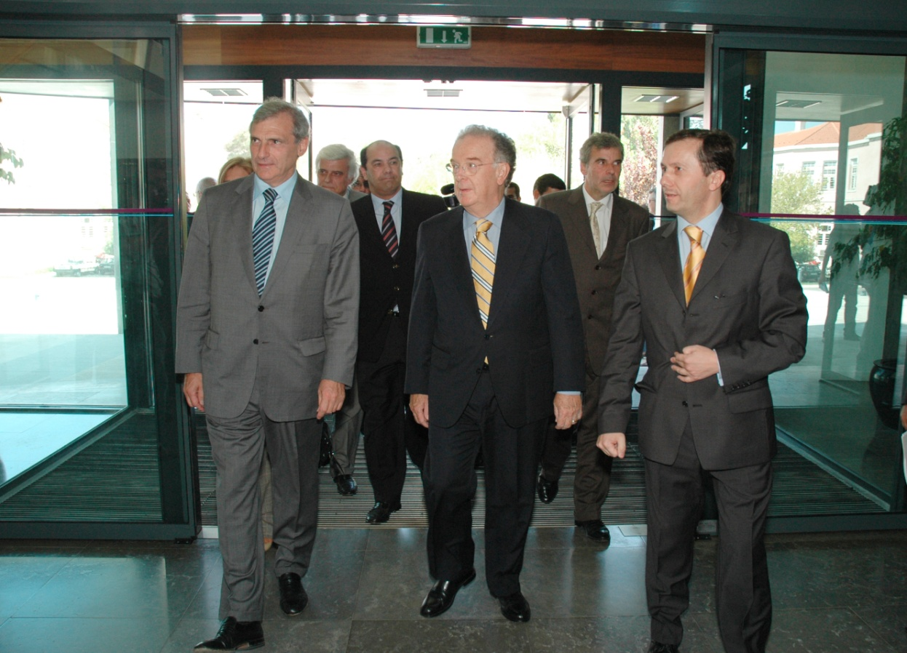
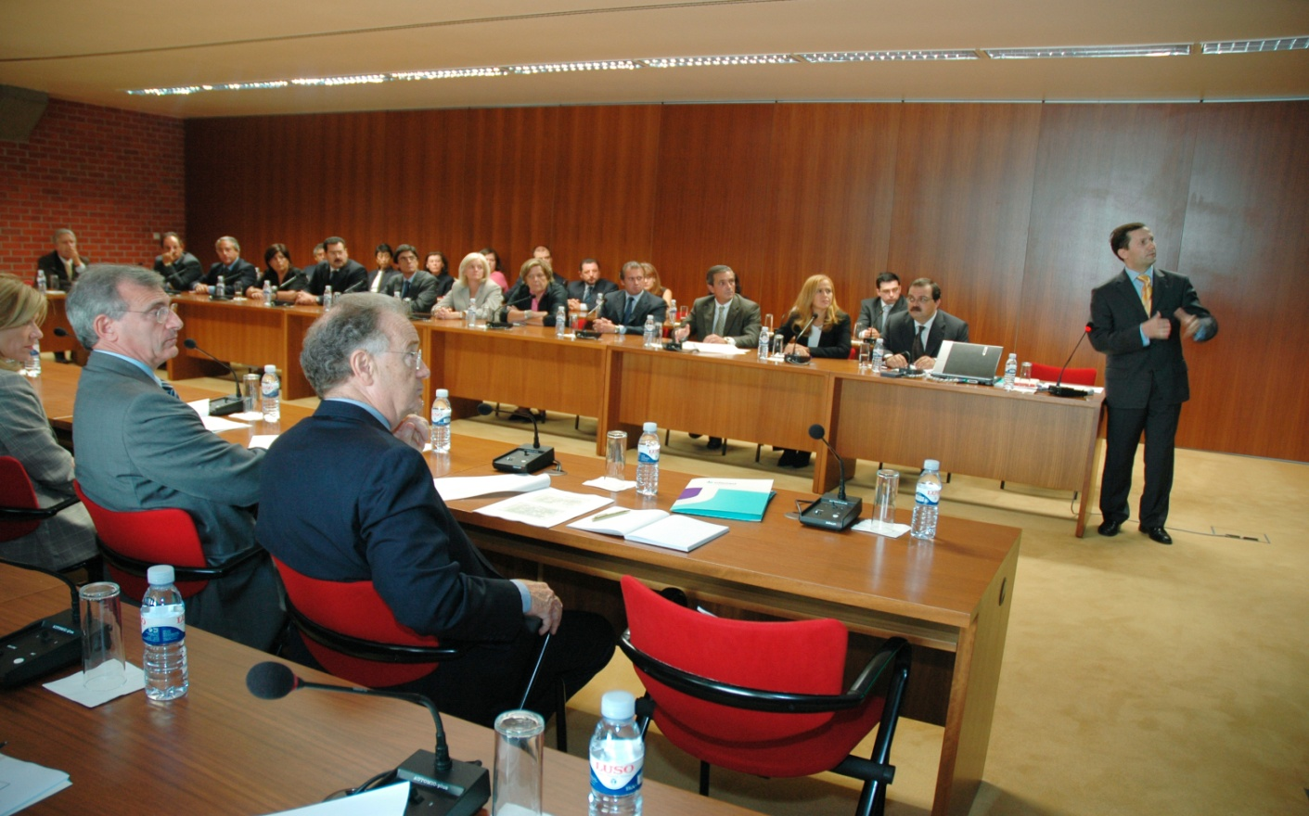
President of the Republic visited INFARMED in September 2004
and called on doctors to prescribe generics

Slide 27
RESULTS

Slide 28
An Integrated Approach

Slide 29
Results
National generics market shares in value
G10 recommendation 4 - To secure the development of a
competitive generics market

Slide 30
Results
International barometer of generics (value)
Portugal presents a higher generics market share than its countries of reference – Spain, France and Italy

Slide 31
Results
Generic presentations on the market
Dec 2001- April 2005
Presentations
Authorised with approved price
Reimbursed
Prescribed

Slide 32
INNs with Approved Generic Medicines

Slide 33
INNs with marketed Generic Medicines

Slide 34
MAH of Approved Generic Medicines

Slide 35
Evolution on Generic Substitution - Physician Authorization

Slide 36
Results
New active ingredients reimbursed

Slide 37
Results
Timeframes
Generics evaluation timeframes for authorisation and reimbursement were significantly reduced from 2002 to 2005.
Today a generic application takes approximately 30 weekdays for conclusion
(47 days in 2002).
Evaluation timeframes available at www.infarmed.pt

Slide 38
Perspectives
Market development
There is a high potential for the Portuguese generics market and the pharmaceutical Industry as more than 50% of the reimbursed active ingredients have lost their patent and have no generic medicines marketed so far.

Slide 39
CURRENT ISSUES

Slide 40
Government goals to the medicines sector
Extend the sales of medicines to other
alternative sales outlets than pharmacies;
Review the current reimbursement system;
Extend INN prescribing to all medicines reimbursed by the State;
Review the reference Pricing System;
Re-evaluate medicines marketing fees;

Slide 41
Government goals to the medicines sector
Establish a protocol between the State and the Industry to control State expenduture with medicines;
Adopt electronic prescription;
Strengthen inspection actions on medicines promotion made to prescribers and in pharmacies;
Launch a programme to improve the quality of prescription;

Slide 42
Current Issues
Recently published study on the evaluation of the Portuguese reimbursement and pricing system;
Possible changes in the Reimbursement Reference Pricing System;
Possible changes in the Pricing System;
Possible review of the reimbursement system.

Slide 43
Current Issues
New Medicines Act
Implementing EU Legislation
Development of QualiMED - a Rational Therapy Network including INFARMED and Regional Health Authorities

