Slide 1
‘Defining emerging in pharma’ Survey*
FC Business Intelligence – London
https://www.surveymonkey.com/sr.aspx?sm=J5q6TUPPdMX7mHtbc0Tj0ROM_2fyGcMvk20ycHo_2f6YMzU_3d

Slide 2
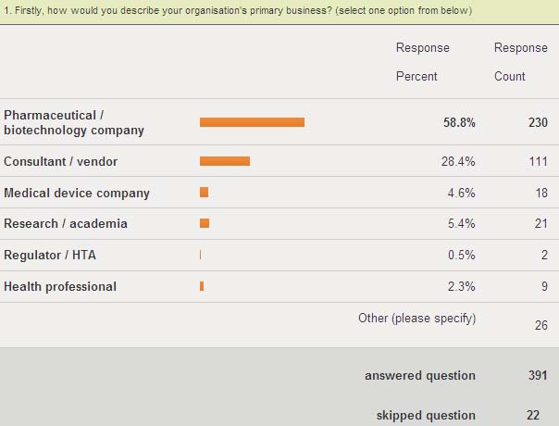

Slide 3
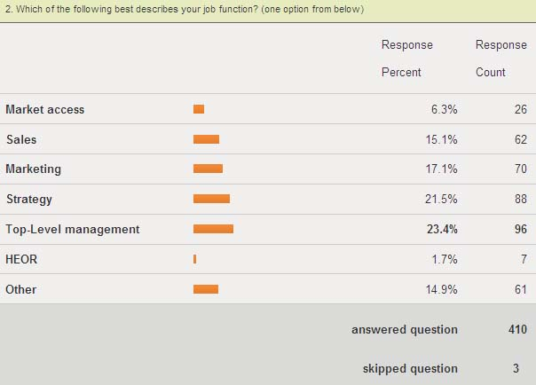

Slide 4
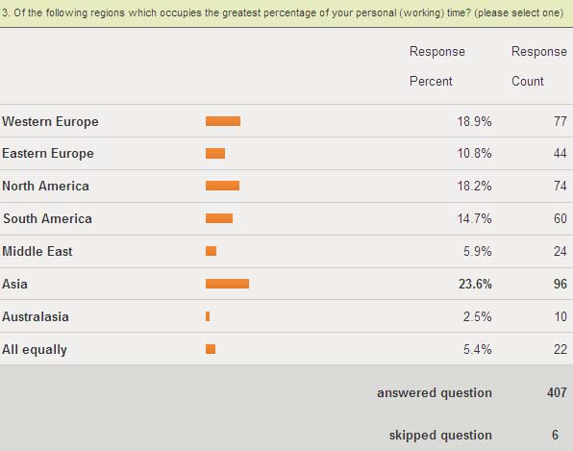

Slide 5
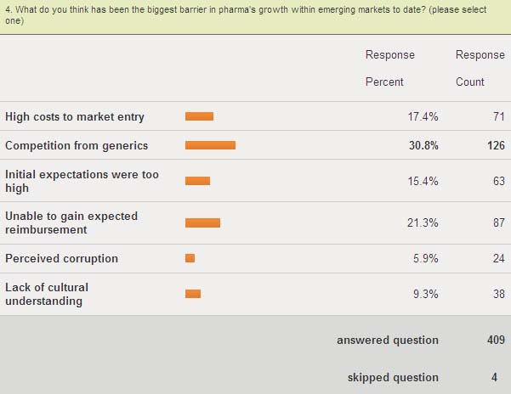

Slide 6
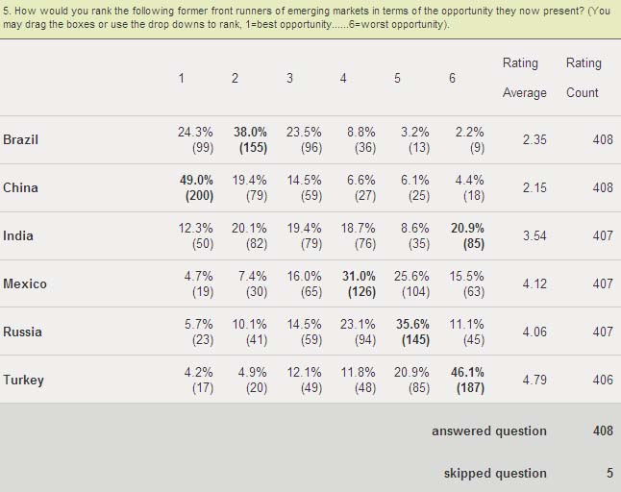

Slide 7
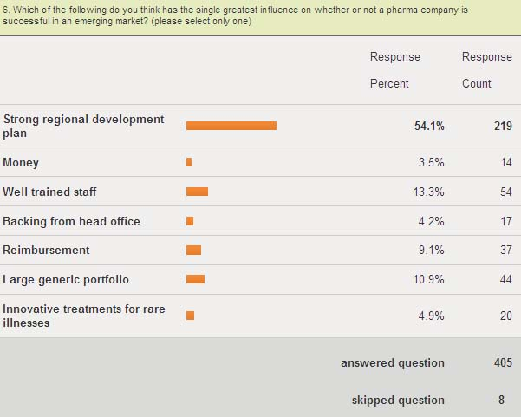

Slide 8
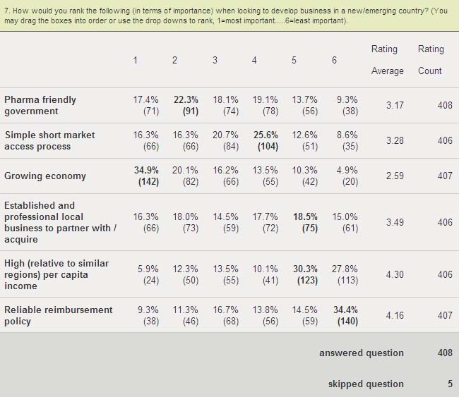

Slide 9
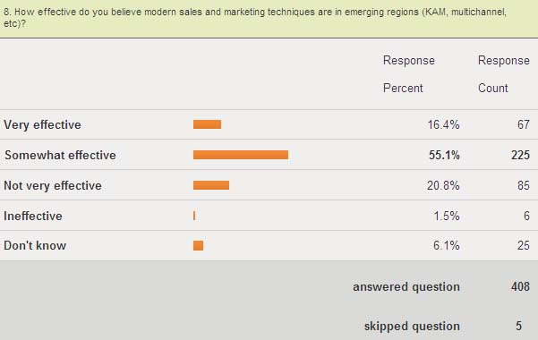

Slide 10
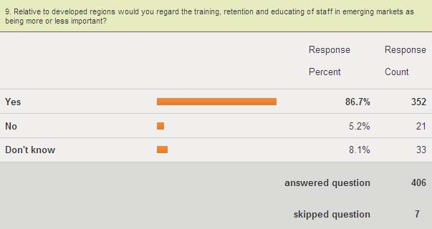

Slide 11
